Slide 1

Convolutional Neural Networks
A simple convolution network example
deeplearning.ai

Slide 2
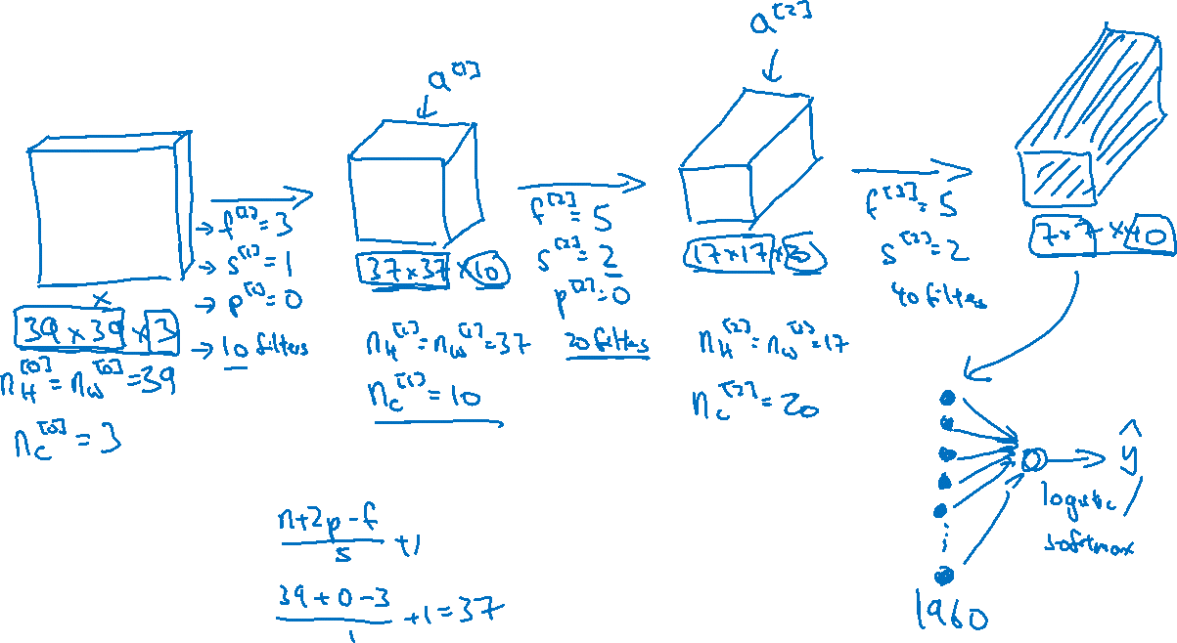
Example ConvNet

Slide 3
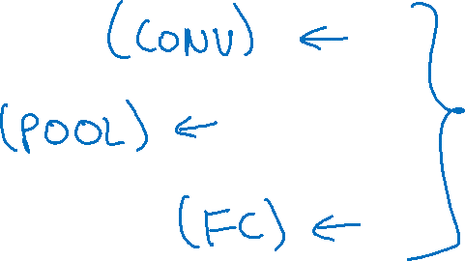
Types of layer in a convolutional network:
- Convolution
- Pooling
- Fully connected

